Slide 1
Effect of Code Clone On Software Quality
By Usman Tahir(012) And Usama Tahir(144)

Slide 2
Index
Introduction
Is Code Clone Dangerous or Not?
Literature Review
Methodology
Disadvantage of Code Clone
Result
Conclusion
Future Work

Slide 3
Introduction
Code Clone
Code clones are the repeated code which reduces the software quality.
OR
In a software system, similar or identical fragments of code are known as code clones.

Slide 4
IS Code Clone Dangerous or Not?
The main reason behind difficulty in software maintenance is code clones which do not lead to conclusion that code clones are only harmful for software development. Code clones can be both advantageous and disastrous for software development. Therefore, clones should be analyzed before refactoring or removing them.

Slide 5
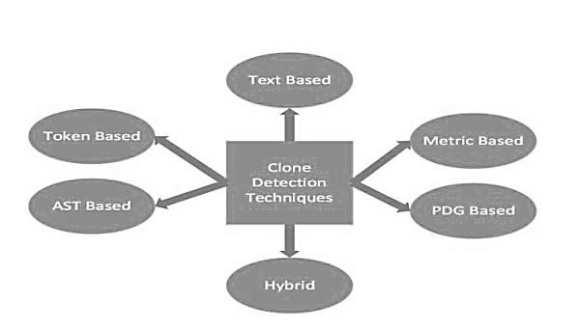
Literature Review
These Techniques are used in the past for the detection and removing of code clone.

Slide 6
Methodology
Tool: DR is one of the tools of the abstract syntax tree based clone method. Compiler is used to produce AST and the compiler relates the sub trees based on selected hash function, the sub trees which are identical and returned as clones.
Approach: Syntactic Method. As Syntactic methodologies use a parser front-end like that of a compiler to transform source programs into parse trees or ASTs which can then be administered using either tree-matching to find clones

Slide 7
Disadvantage of Code Clone
Increased probability of bug propagation
Increased probability of introducing a new bug
Increased probability of bad design
Increased difficulty in system improvement/
Modification
Increased maintenance cost
Increased resource requirements

Slide 8
Result
Helps in understanding the program
Helps to research aspect mining
Finds patterns of usage
Malicious software is Detects
Detection of plagiarism and copyright infringement
Helpful in code compacting

Slide 9
Conclusion
In this paper we explain that inconsistent clones compose a very big source of problem, which means that cloning may be a considerable issue during development and maintenance, unless particular care is taken to detect and trace existing clones.

Slide 10
Future Work
Future work on this subject will evolve in several ways.
One evident improvement is the modification of the algorithms,
techniques and tools used. This includes distinguished
heuristics to speed up, the clone search and execute automatic assessment to remove irrelevant clones.

Slide 11
Thank
YOU

